Slide 1
Getting Started User Guide

Slide 2
Getting Started with IEEE DiscoveryPoint
3
User Guide Contents
Find general information about IEEE DiscoveryPoint for Communications, plus frequently asked questions (FAQs) on these popular topics:
Search
9
Analyzing & Understanding Search Results
15
Sharing Search Results
20
Dashboards/Expert Searches
24
My DiscoveryPoint
28
Setting and Personalization
32

Slide 3



Getting Started with IEEE DiscoveryPoint
The IEEE DiscoveryPoint platform has been designed with the needs of communications engineers in mind—but every platform needs an introduction.
Key Questions
What is IEEE DiscoveryPoint for Communications?
What content can be found in IEEE DiscoveryPoint?
How do I create an account?
How do I log in to IEEE DiscoveryPoint?
What do the different icons mean?

Slide 4




What is IEEE DiscoveryPoint for Communications?
IEEE DiscoveryPoint is an all-in-one information platform built for engineers in industry to support the design and development of technology solutions, by offering:
Trusted Sources
Find answers to technical questions by referencing relevant content from high-
quality sources.
All-in-One Search
Avoid time wasted searching multiple databases and find all the information
you need in a single platform.
Focused Communications Content
Easily find project-specific information by searching expertly curated communications-
focused content.
Practical Industry Data
Discover solutions for real-world design challenges with resources tailored to
support engineers in industry.

Slide 5
What content can be found in IEEE DiscoveryPoint?
The IEEE DiscoveryPoint platform brings communications focused information together from hundreds of high-quality, reliable, and vetted sources:
Research: Full-text of communications-related content from IEEE and SMPTE
Books: Full-text of communications-related eBook titles from leading publishers
Standards: Industry guidelines and standards, including full-text IEEE Standards
White Papers: Direct links to reports and position papers
eLearning: Full access to self-paced educational courses from IEEE and direct links to courses from manufacturers
Parts & Components: Relevant equipment and parts solutions from distributors and manufacturers
Industry & Product News: Direct links to online business and technology news
Blogs & Commentary: Direct links to opinion and idea content related to communications
Events: Information on upcoming IEEE conferences, symposiums, and other events
Expert Searches: Collection of ready-made search queries by communications experts, designed to capture the most relevant content
View a more detailed listing of content sources

Slide 6

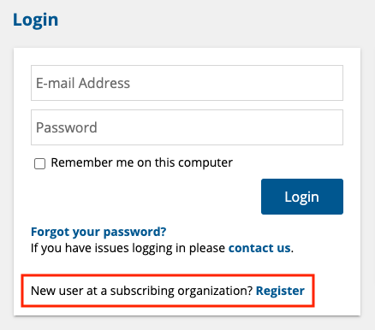
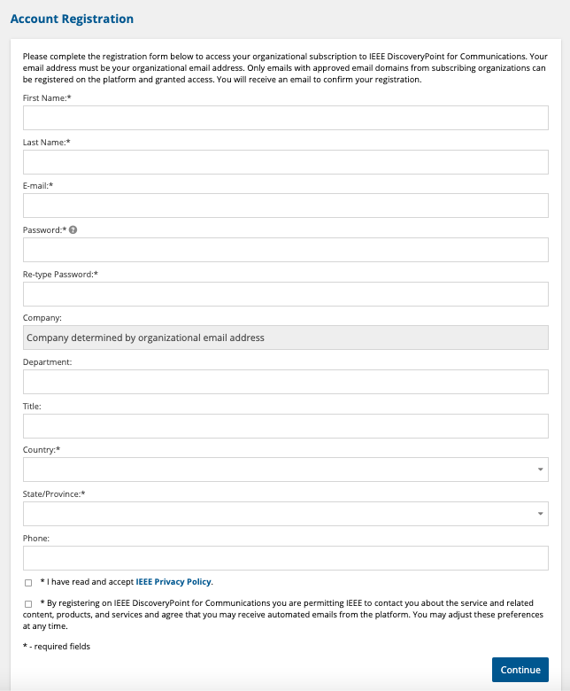
How do I create an account?
Go to discoverypoint-comms.ieee.org
Click Register at the bottom of the login window
Fill out the Account Registration form and click Continue
TIP:
Make sure to register with an active, organizational email address from an approved email domain to be granted access.

Slide 7
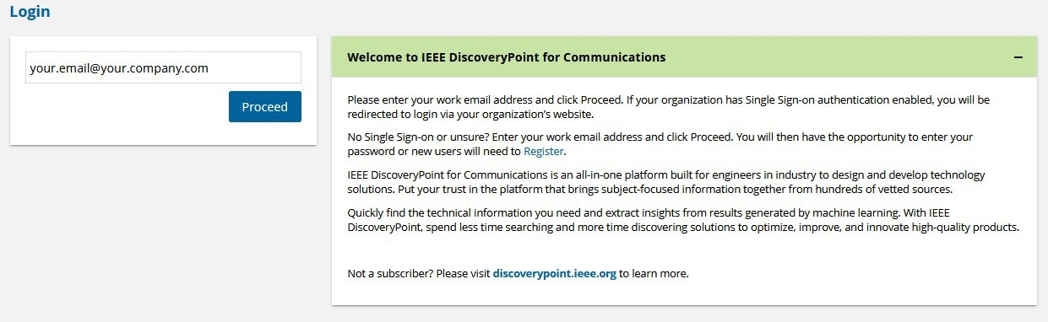
How do I log in to IEEE DiscoveryPoint?
Log into IEEE DiscoveryPoint at discoverypoint-comms.ieee.org using your email and password.
Forgot your password? From the second login window, select the Reset your password link, specify your registered email and select the Continue button. Your password will be reset, and notification of follow-up steps will be sent to you by email.

Slide 8








What do the different icons mean?
On the blue navigation bar:
Throughout the platform:
Profile
Access your profile; update settings
Search for content
Access Actions
Customize
widget settings
Hide details
Help
Access user help; view full content list
Contact
Send questions; submit feedback
Minimize
content window
Show details
Maximize
content window
Reset to base settings
Edit
Delete

Slide 9
Search
The IEEE DiscoveryPoint platform allows you to search subject-focused information from hundreds of high-quality and vetted sources using intuitive search features.
Key Questions
How do I perform a quick search?
How do I work with the All Results Page?
How do I sort my Search Results?
How do I save a Search?
What additional options do I have with Advanced Search?

Slide 10

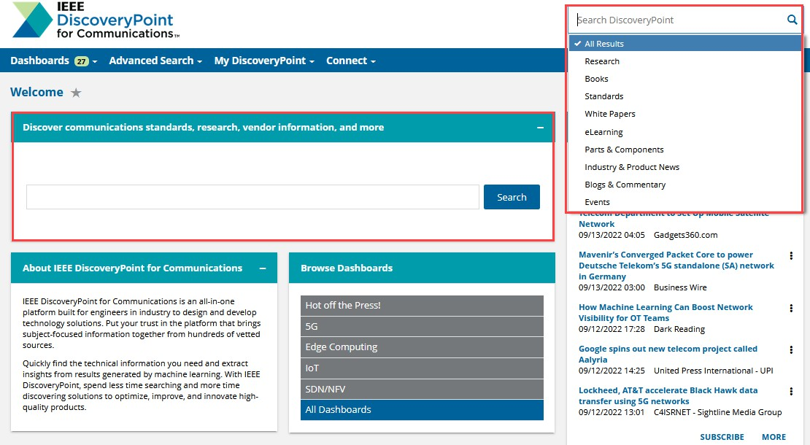
How do I perform a quick search?
You can perform a quick search in two places:
Main Search Box at the center of the Welcome page
Type in your search terms
Click on the Search button to search all content
Quick Search Box at the top right corner of every page
Type in your search terms
Select All Results or a specific content Channel from the drop-down menu
Click on the search icon
Main Search Box
Quick Search Box

Slide 11
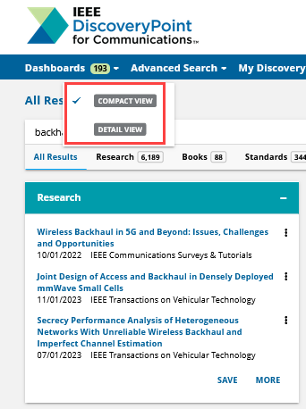
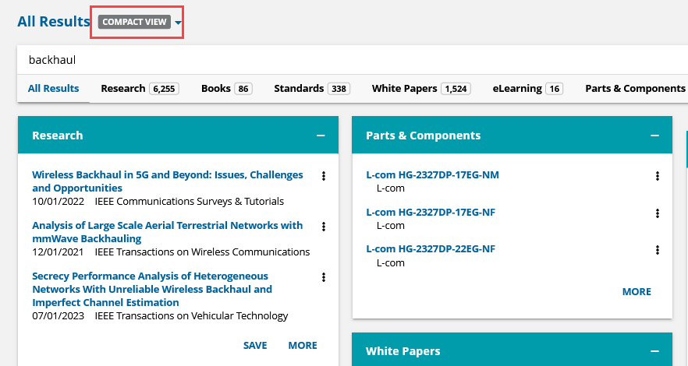
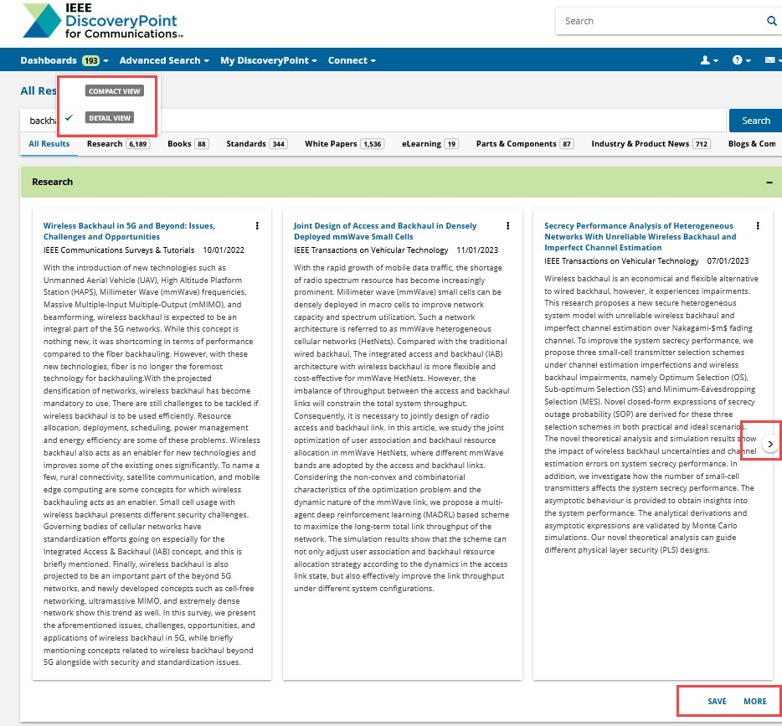
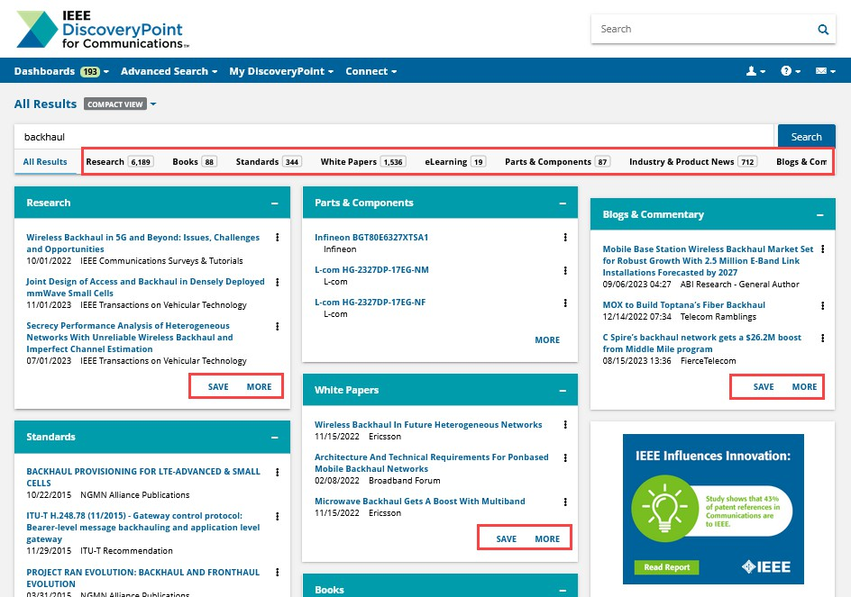
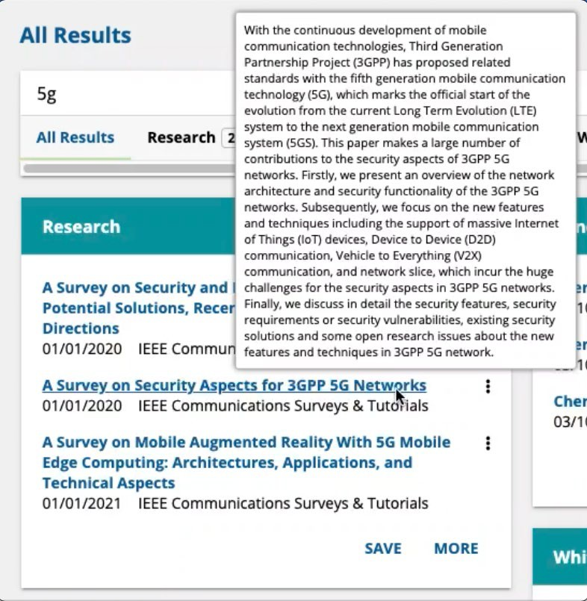
How do I work with the All Results Page?
After entering and running your search, you will see a full listing of results from all Channels. IEEE DiscoveryPoint for Communications provides two views for your inquiries displayed on the All Results page.
Compact View displays the title, source, and date of documents in each channel.
Detailed View displays each channel occupying its own row of results with a horizontal magazine-type page scroll to see the next set of results for your query. Each result in Detailed View displays the complete abstract of each article following its citation enabling you to assess more quickly if an article matches your interest.
From any of these Channel boxes, you can switch between two views using the dropdown list field next to the All Results page name.
Click MORE to see the complete results for that content set
Click SAVE to create a Saved Search
You can also click on any of the collections, under the main search box, to see the full results list for that Channel.
TIP:
Hold your cursor over the link within a search result box to get an overview of the document.

Slide 12
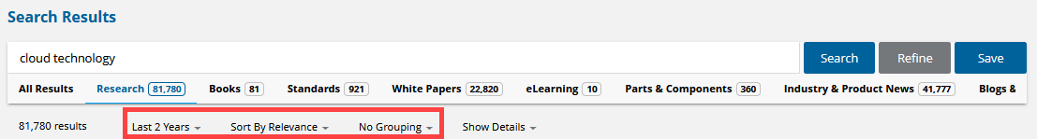
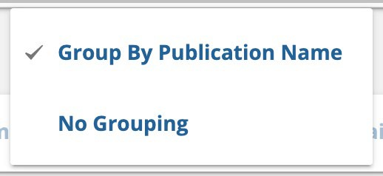
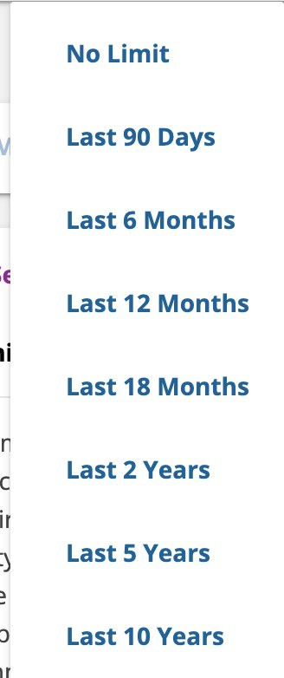
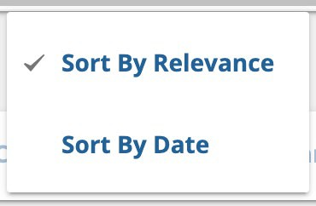
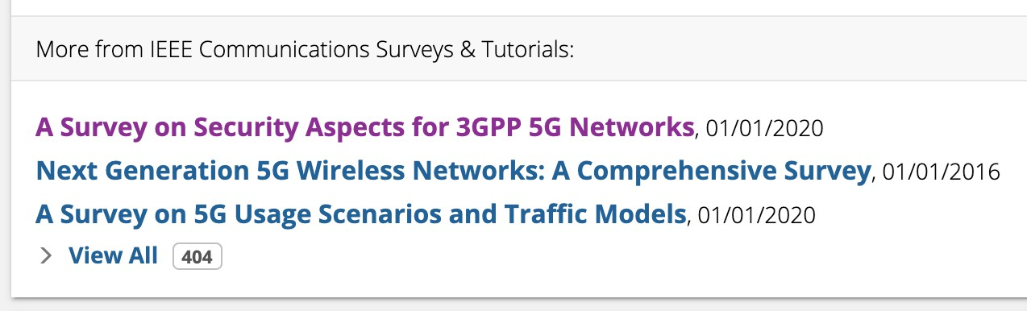
How do I sort my Search Results?
Use the drop-down menus below the search box to sort your search results by:
Timeframe: Choose the search timeframe
Relevancy:
Switch between Relevance and Date
Publication Name:
Switch between No Grouping and Group By Publication Name
Selecting Group By Publication Name/Source will add a More from section at the bottom of every search result with the top results from that publication and the option to view all results.

Slide 13
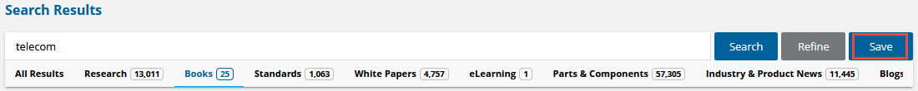
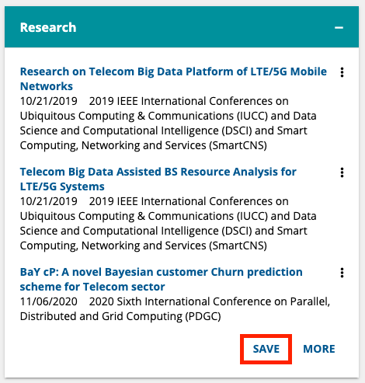
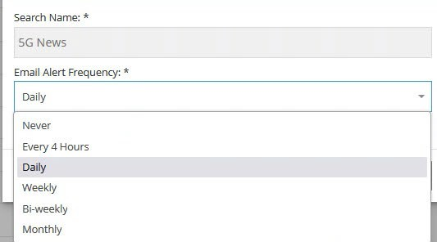
How do I save a search?
The Save Search function on IEEE DiscoveryPoint is an easy way to keep updated on your topics of interest.
There are two ways to save a search:
All Results
Once you have conducted a quick search, click SAVE in a Channel’s box to create a Saved Search.
Advanced Search Results
Click the Save button to the right of the main search bar.
In the Save Search window:
Enter a name for your search and choose your alert frequency (Never, Every 4 Hours, Daily, Weekly, Bi-weekly, or Monthly)
Click the checkbox if you wish the search to be added to My Dashboard
Select Save

Slide 14
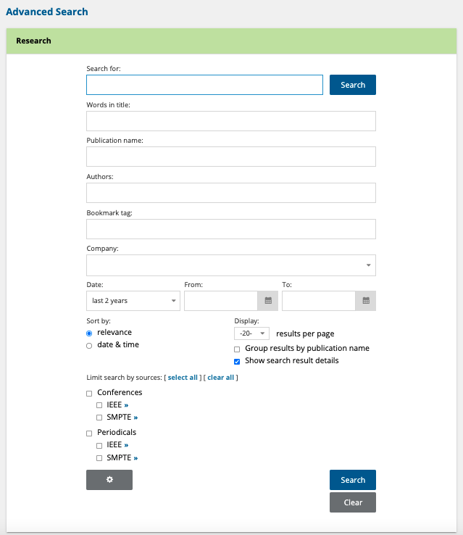

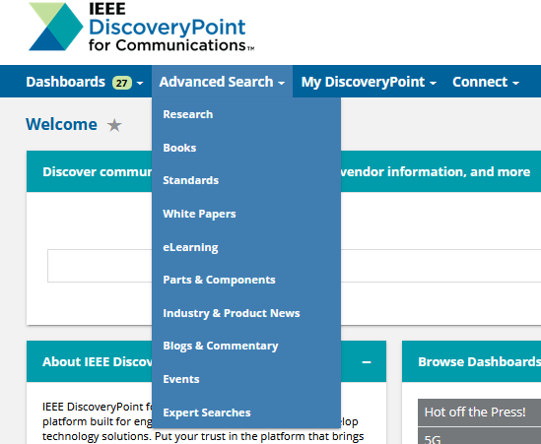
What additional options do I have with Advanced Search?
The Advanced Search forms can be found for each Channel listed in the Advanced Search drop-down, in the blue navigation bar at the top of the page.
Beyond keywords within the document, you can customize your search using the following fields:
Note: Specific search fields will vary by content Channel, and not all fields will be available on all Channels.
Words in Title
Publication/Standard Name or Source
Authors
Bookmark tag
URL
Company
Language
Category
Manufacturer
Location
Date Range
The results can be sorted by date or relevance.

Slide 15
Analyzing & Understanding Search Results
IEEE DiscoveryPoint uses machine learning to analyze your search results—providing you with a better understanding of the content.
Key Questions
What is the More Like This button?
What are Excerpts? How do I view Excerpts?
What is on the MI Analyst page?
What are Topics? How do I view Topics?

Slide 16
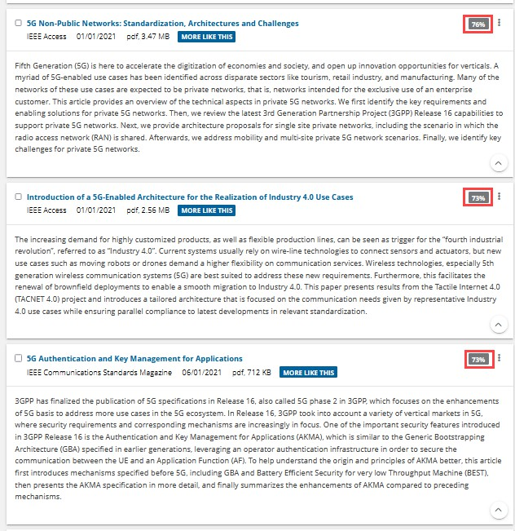
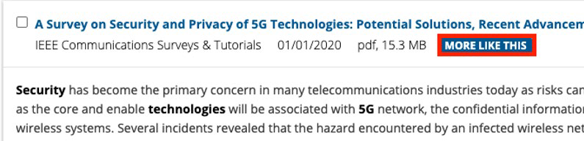
What is the More Like This button?
In the results list, use the More Like This button to find content similar to a particular record.
Clicking the More Like This button replaces the search query based on elements from the selected record and automatically generates a new search result list of on-target items.
Each result listed after the original record shows its Likeness Score—a percentage ranking that indicates how similar each document is to the original.

Slide 17
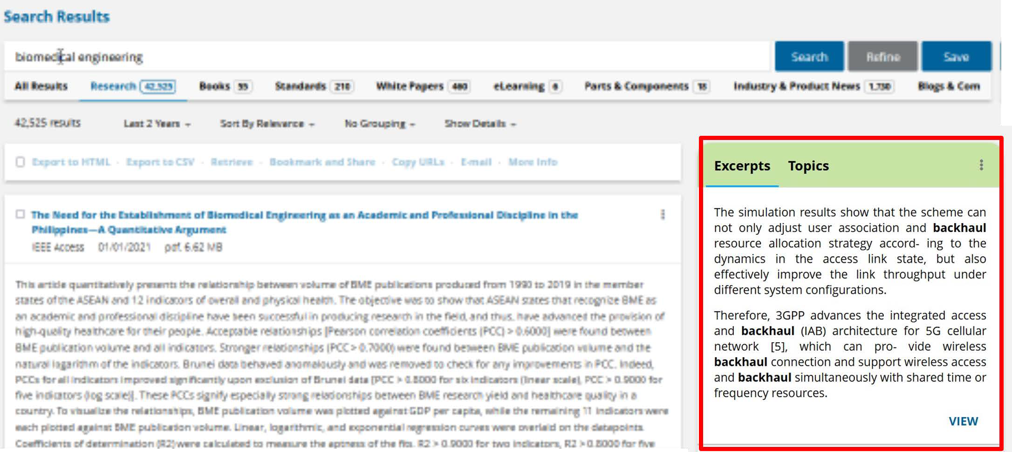
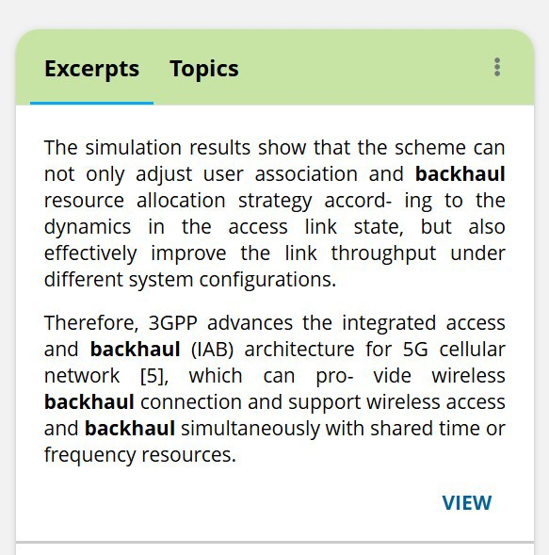
What are Excerpts?
Excerpts are brief, easy-to-read key points extracted from search results found in IEEE DiscoveryPoint resources like Research, Books, Standards, White Papers, eLearning, Industry & Product News, and Blogs & Commentary.
The built-in tool is designed to help you work through projects in less time by pinpointing the most relevant information contained in documents and directing focus to the materials that are most likely to contain solutions.
How do I view Excerpts?
In the right column of your search results page, you will see a box with two tabs titled Excerpts and Topics. Click on the Excerpts tab to view relevant snippets from the documents in your results set listed below the tab. Click VIEW to read the full-text of the document.

Slide 18
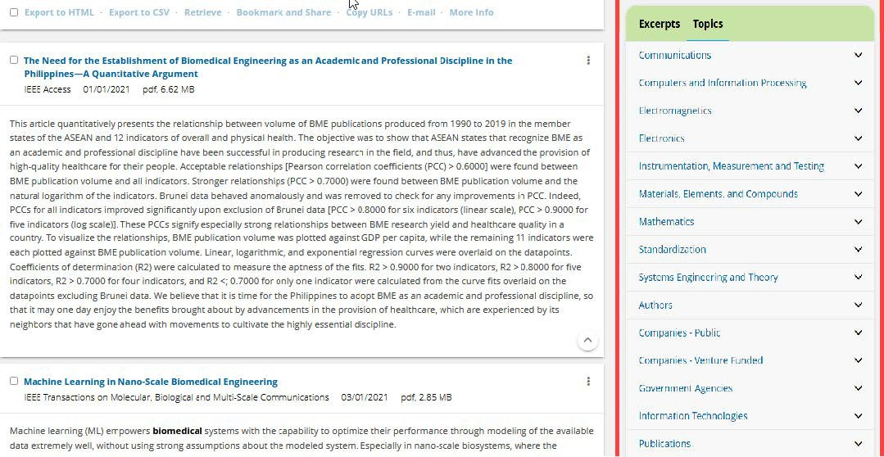
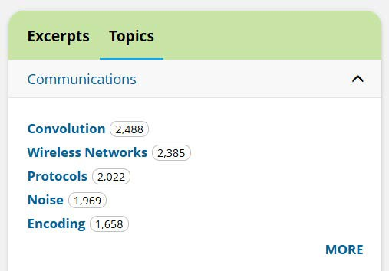
What are Topics?
The Topics widget allows you to explore concepts within your search results. IEEE DiscoveryPoint uses taxonomies to highlight topics pertinent to your search—letting you use Topics to further refine your research or explore related ideas.
How do I view Topics?
To view Topics, click on the Topics tab in the right-hand module of your search results page.
Individual concepts are extracted from your search results documents and organized into technology and business-related topics areas. The number of results for each topic is also indicated.

Slide 19
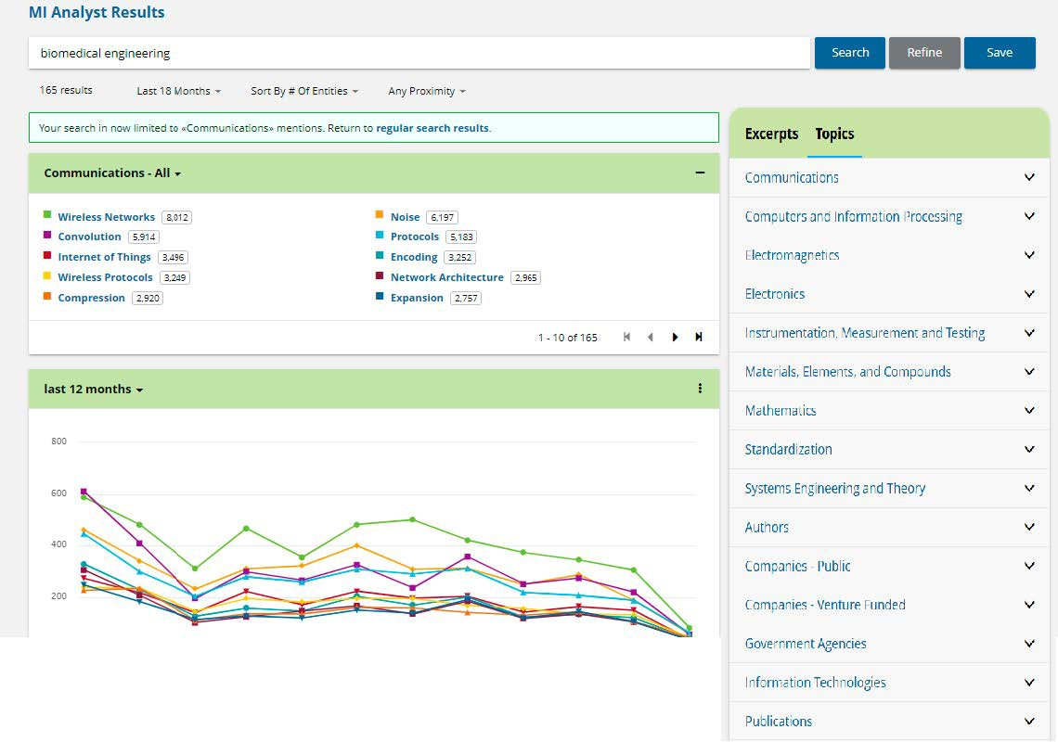
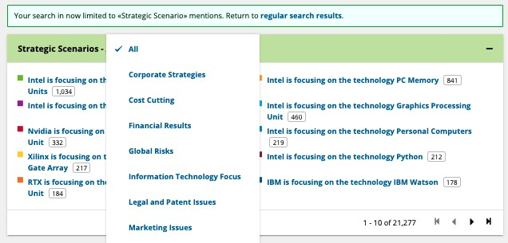
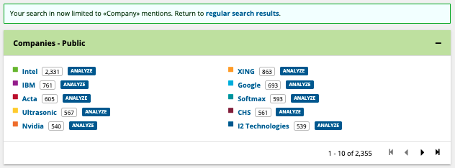
What is on the MI Analyst page?
Each MI Analyst Results page in IEEE DiscoveryPoint offers several additional data points about the Topic, expressed as trend graphs and charts.
Many of the Topic areas have an additional filter where you can further focus your search results, based upon relevant sub-categories.

Slide 20
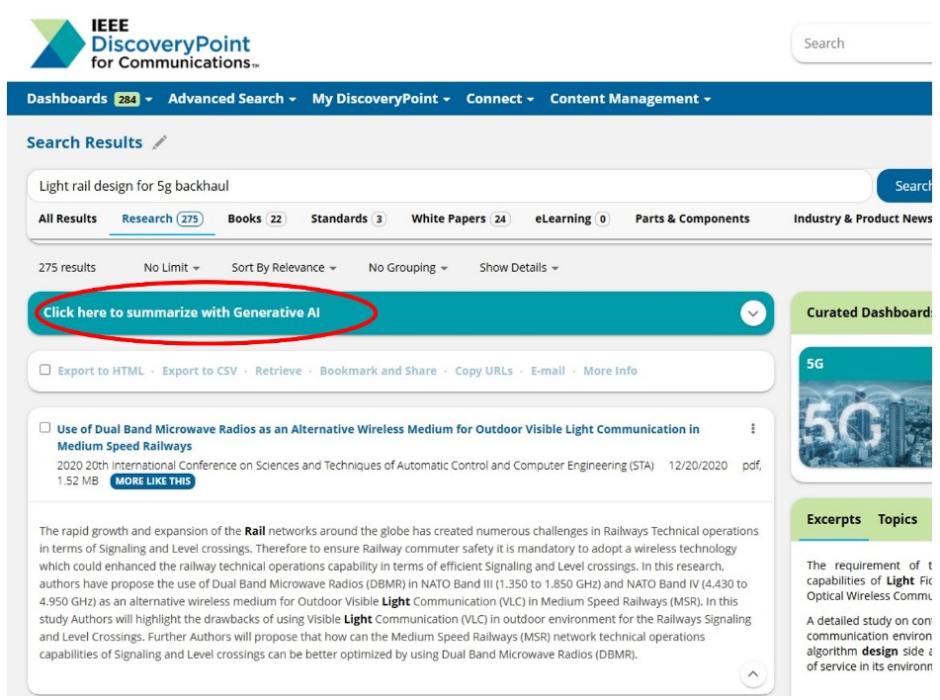
What is the AI Insights Tool?
The AI Insights Tool is a set of AI-powered summarization and chat features that help users understand and ask questions about specific IEEE articles. The responses provided are based solely on the content of the article or articles being queried. This built-in generative AI-powered assistant within the IEEE DiscoveryPoint platform delivers:
Executive summaries based on the user’s top 20 research search results.
AI-generated insights at the individual research article level.
AI-driven Q&A follow-up chat feature for contextual exploration within IEEE research content.
How do I use the AI Insights Tool?
How It Works
The AI Insights Tool is integrated into the IEEE DiscoveryPoint platform and is available as part of the IEEE DiscoveryPoint for Communications subscription.
These features are deployed on content within the Research Channel, enabling you and your colleagues to quickly and accurately generate Executive Summaries of your search results as they relate to your inquiry, view an Insight summary of a specific article to judge how it addresses your question, and query an article directly to explore its content.

Slide 21
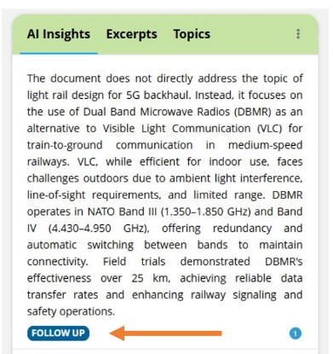
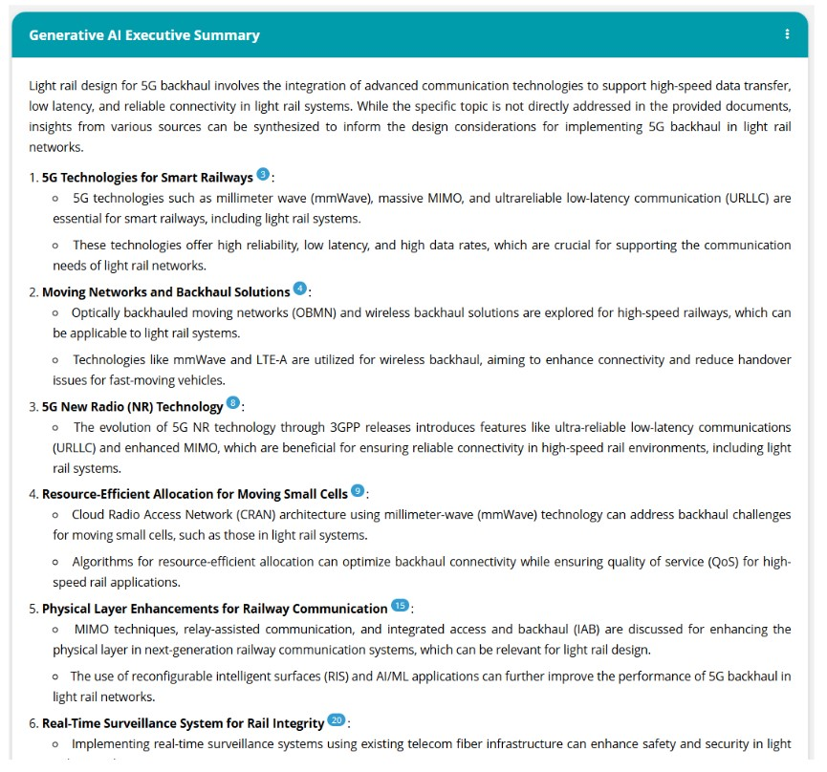
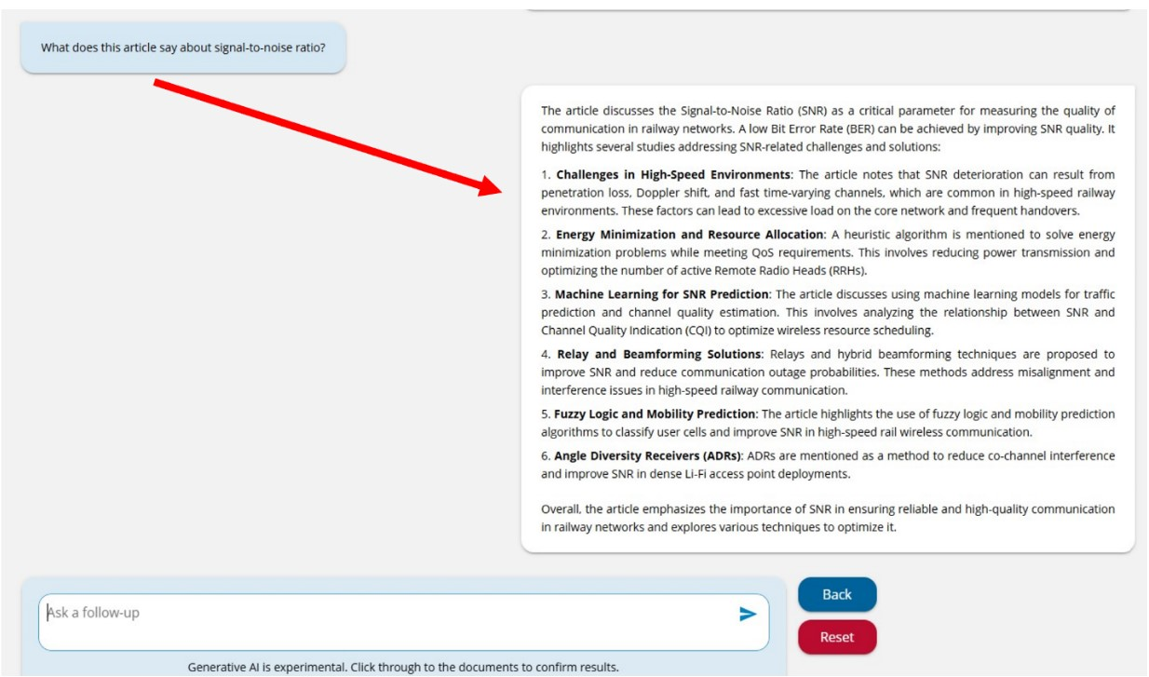
Enhancing IEEE DiscoveryPoint with the AI Insights Tool
Users can generate Executive Summaries of their search results with a mouse click or automatically trigger the AI tool by phrasing their search as a question and adding a question mark to the end of the search query.
The AI Insights Tool also generates succinct Insight summaries at the article level - providing deeper context for each research article returned by your search query.
Clicking “Follow Up” beneath any Insight opens up a Q&A chat feature where you can direct additional questions to the article selected. ​The AI-generated responses are based exclusively on the content of the article being reviewed.

Slide 22
IEEE Data Privacy Policy
IEEE remains committed to deploying innovative tools in a manner that is secure, responsible, and compliant with our customers’ requirements for confidentiality and data governance.
To that end, we have established strict contractual and technical safeguards with our platform and AI technology providers to ensure the protection of IEEE DiscoveryPoint users’ confidentiality and security and IEEE’s intellectual property. These safeguards include:
Prohibition of Model Training and Service Improvement: Our providers are prohibited from using IEEE content or IEEE DiscoveryPoint customer usage to train, fine-tune, or otherwise improve any Large Language Models or related products.
Access and Retention Restrictions: Our AI provider is not permitted to access, review, or retain IEEE DiscoveryPoint customer usage.
Encryption Standards: All data and IEEE DiscoveryPoint customer queries are protected using industry-standard encryption protocols.
Authorized Use Only: Our AI provider may use customer queries solely to support responses to the features within IEEE DiscoveryPoint.
If you have any questions or concerns about this Privacy Policy or about the use of your personal information, please feel free to contact us by email at privacy@ieee.org.

Slide 23
Sharing Search Results
IEEE DiscoveryPoint offers a variety of ways for you to share search results, making it easy to collaborate with your team.
Key Questions
How do I email documents to other platform users?
What are bookmarks?
How do I bookmark content?

Slide 24
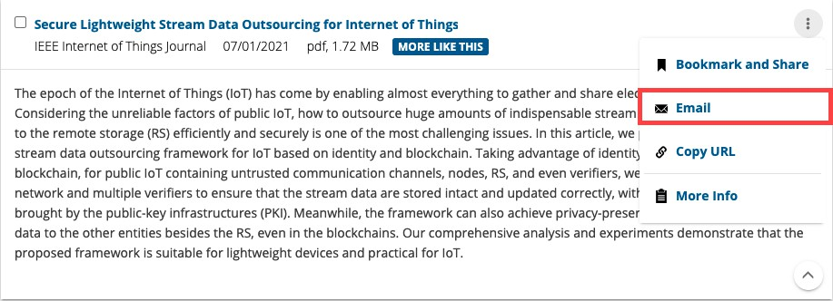
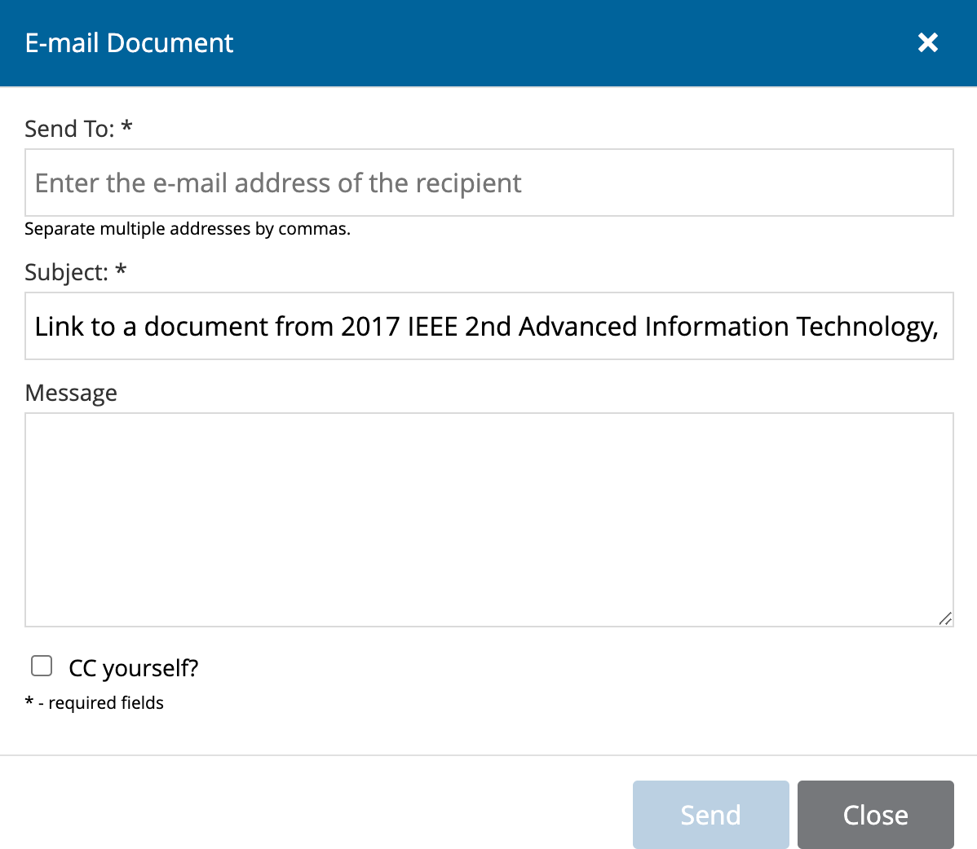
How do I email documents to other platform users?
You can email a document by clicking the Actions icon and selecting the Email link. This opens an overlay window to facilitate the email.
You can email a link to the full summary of the document, if available, to any other platform user.

Slide 25
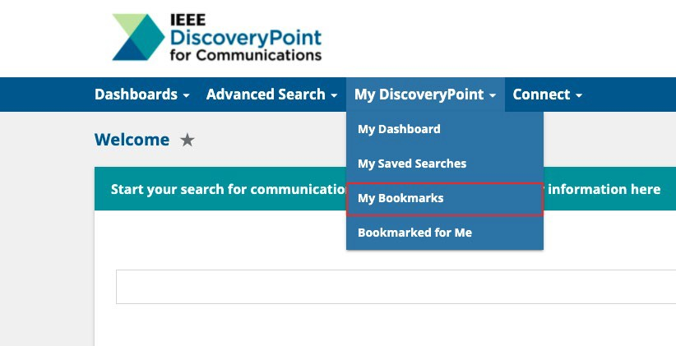
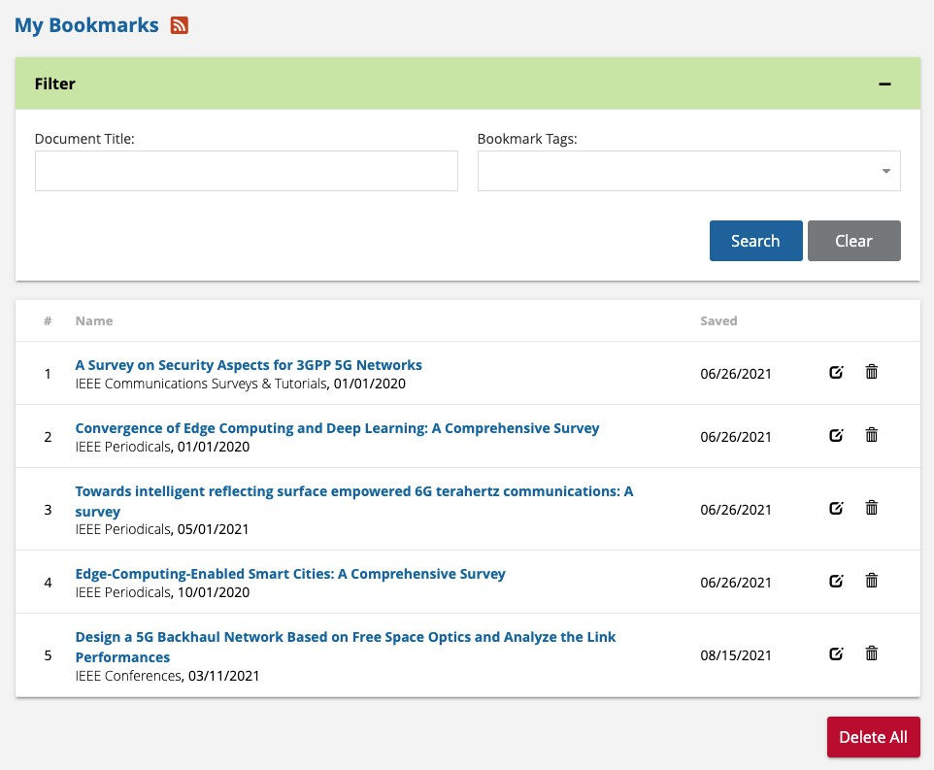

What are bookmarks?
Bookmarks are links to favorite documents located on IEEE DiscoveryPoint—yours and those created and shared by colleagues within your organization.
You can access your bookmarks by clicking the
My DiscoveryPoint drop-down in the blue navigation bar at the top of the screen. Select My Bookmarks.
On the My Bookmarks page, you can filter your bookmarks by Document Title or Bookmark Tags. You can also edit or delete your bookmarks.

Slide 26
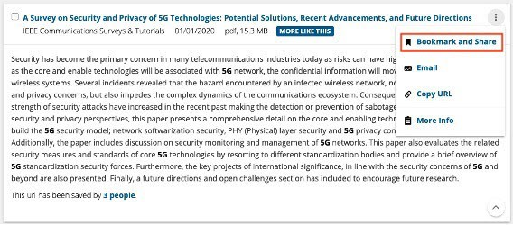
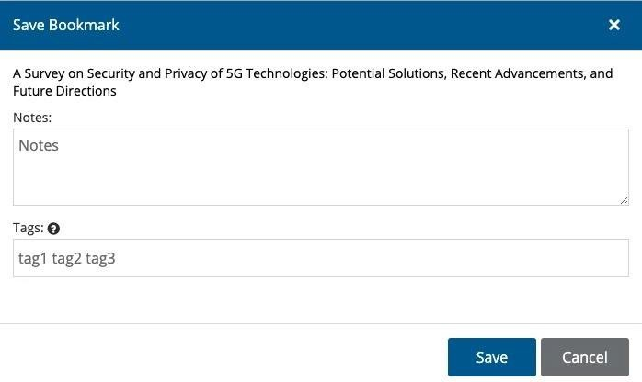
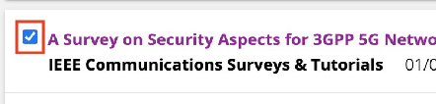
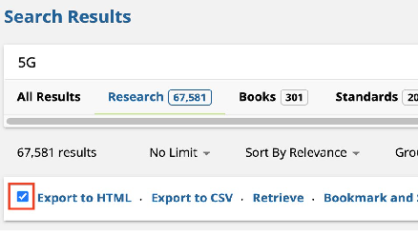
How do I bookmark content?
You can bookmark a document by clicking the Actions icon and selecting the Bookmark and Share link.
TIP:
You can bookmark and share multiple results by clicking the check boxes to the left of the titles and selecting Bookmark and Share just under the filtering options.
This opens an overlay window to facilitate saving the bookmark. In the Save Bookmark window, you can add Notes related to the content and add Tags.

Slide 27
Dashboards & Expert Searches
Created and maintained by IEEE subject matter experts, Dashboards and Expert Searches provide quick access to coverage of hot topics pertinent to engineers.
Key Questions
What are Dashboards?
How do I view Expert Searches?
How do I subscribe to Expert Searches?

Slide 28
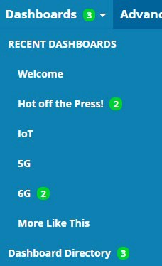
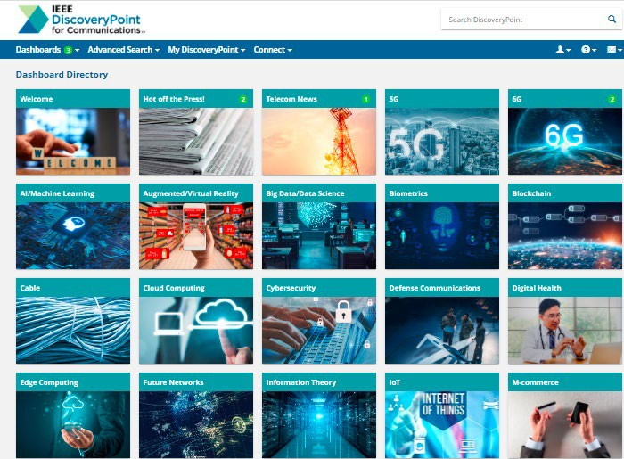
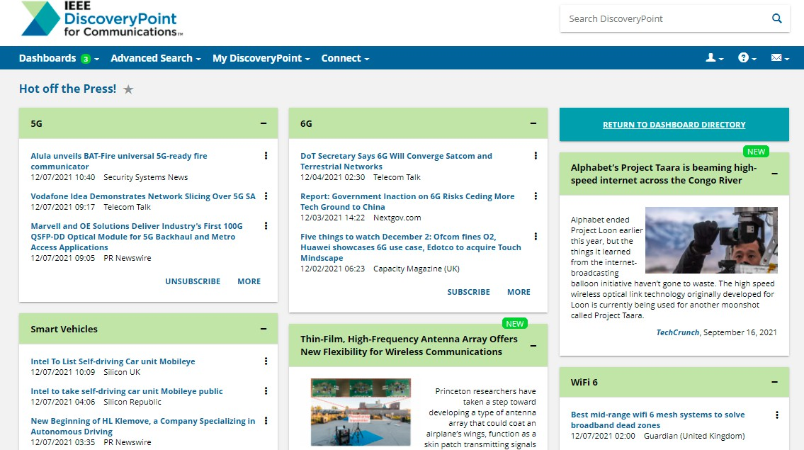
What are Dashboards?
Dashboards on IEEE DiscoveryPoint are curated pages that highlight research and trends of selected communications topics.
TIP:
When keywords from your search correlate with the subjects covered by available Dashboards, Curated Dashboards on this Topic will appear on the results page as clickable thumbnail images
You may see numbers in a green circle when
viewing the Dashboard drop-down menu and Dashboard Directory. This indicates the number of unread and updated items since the dashboard was last accessed.
Click on the Dashboards drop-down menu in the blue navigation bar. Your Favorite Dashboards and Recent Dashboards will appear at the top of the drop-down list. Click the Dashboard Directory to view all Dashboards.

Slide 29
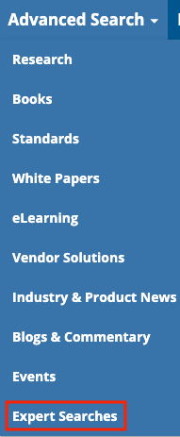
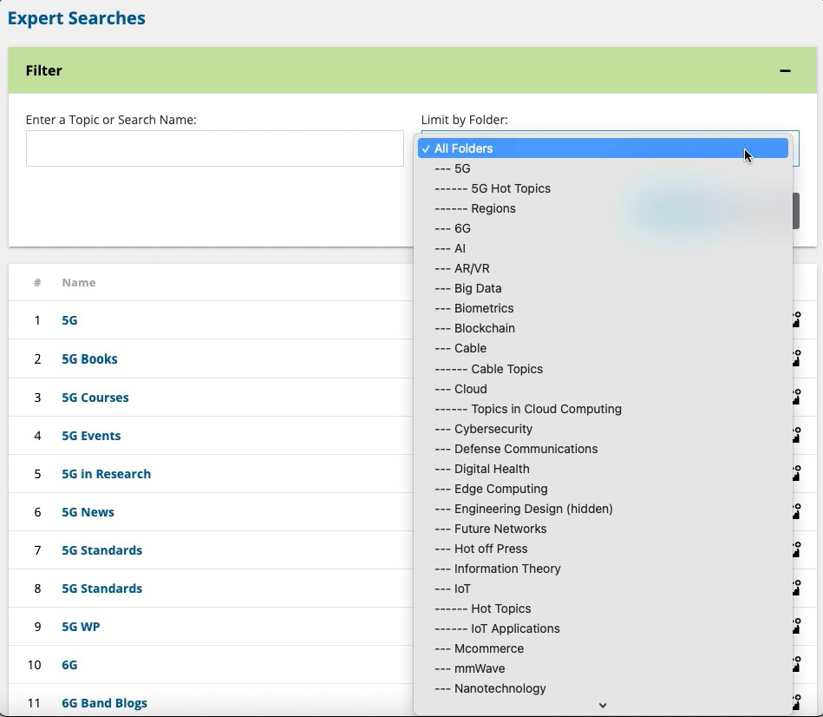
How do I view Expert Searches?
IEEE DiscoveryPoint provides Expert Searches to deliver search results with high precision on a variety of relevant topics for users to browse. To view Expert Searches, go to Advanced Search (drop-down) on the blue navigation bar and open the Expert Searches page.
You may view all searches or search for existing searches. Use the drop-down to limit your search to a specific folder, or search through all folders.

Slide 30
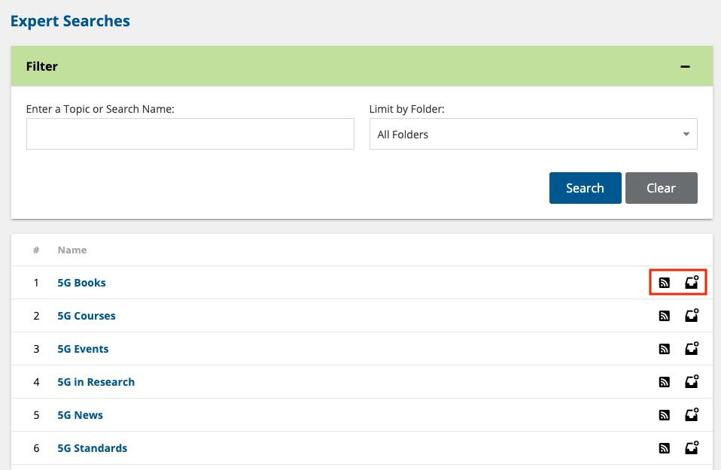
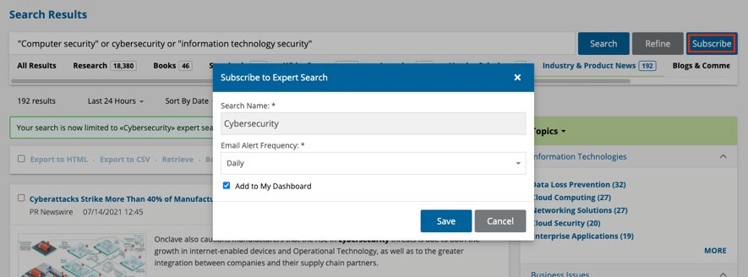
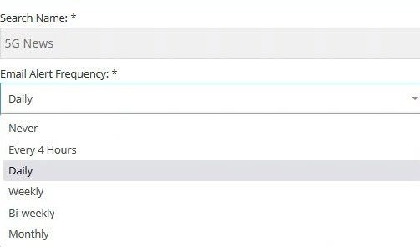
How do I subscribe to an Expert Search Alert?
Click the RSS icon to subscribe to an RSS feed of new search results; or click on the Subscribe icon to receive a periodic email update whenever new results are added to content Channels.
You may also subscribe to an Expert Search when viewing the results of
the search, by clicking the Subscribe button on the right side of the search bar on the search results page:
A subscription overlay will appear. From here, you can subscribe to email
notifications based on frequency of alerts.
Your notification options are "Never", "Every 4 Hours", "Daily", "Weekly“, “Bi-weekly”, or "Monthly".
Click on the Save link.

Slide 31
My DiscoveryPoint
The My DiscoveryPoint drop-down is a gateway to your personalized pages within IEEE DiscoveryPoint.
Key Questions
What is the My DiscoveryPoint drop-down menu?
What is My Dashboard?
How do I add new content to My Dashboard?

Slide 32

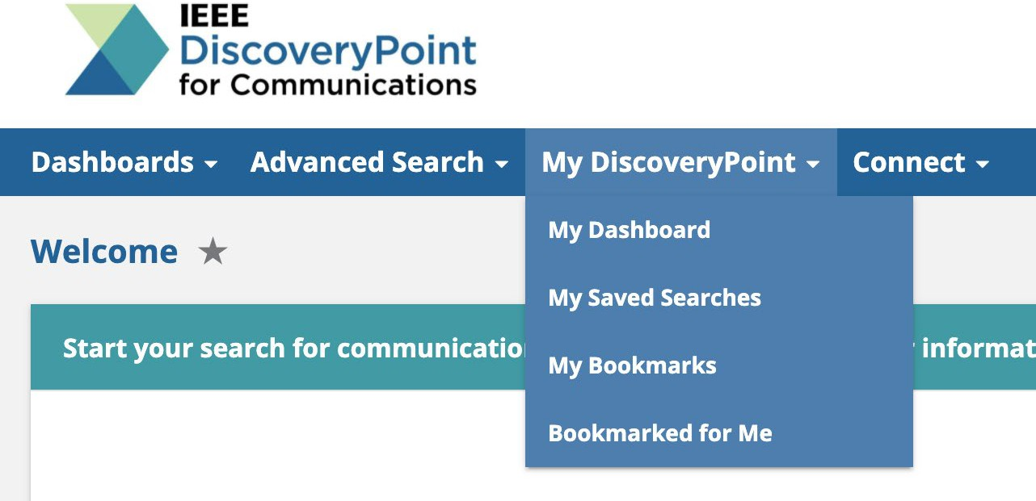
What is the My DiscoveryPoint drop-down menu?
The My DiscoveryPoint drop-down is a gateway to your personalized pages within IEEE DiscoveryPoint for Communications.
You will find links to:
My Dashboard
My Saved Searches
My Bookmarks
Bookmarked for Me

Slide 33

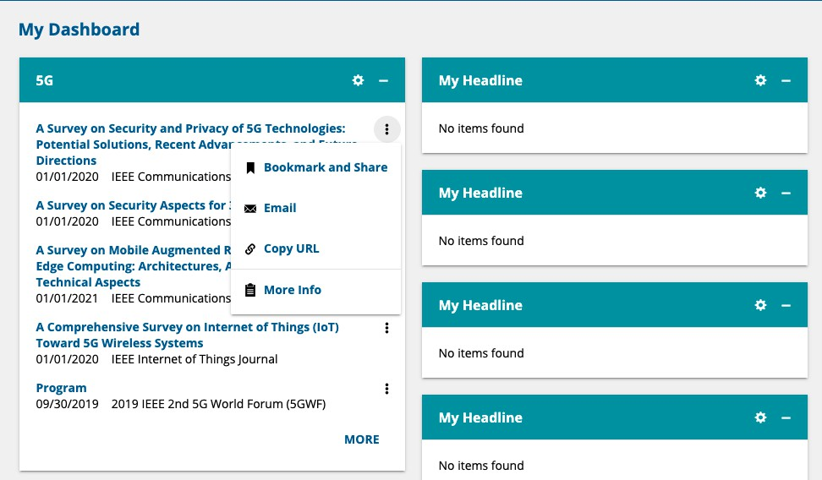

What is My Dashboard?
My Dashboard is a personal dashboard that can be customized for your specific information needs with:
Saved Searches or Expert Searches
Recommended Reading Lists
My Groups
TIP:
You may change the placement of existing boxes on the page by dragging and dropping them with the drag icon
Initially, all the widget boxes are called My Headlines. You may configure up to 16 headline widgets. You may open or close boxes and change their positions on the page.

Slide 34





How do I add new content to My Dashboard?
Add new content by clicking the Customize icon on the “My Headline” header, or click the “Customize” icon at the top right of an existing My Headline box.
Select your desired Saved or Expert Search from the drop-down lists:
TIP:
You may also save searches to an empty Headline widget immediately after you create them, by clicking the Save button. Check the Add to My Dashboard box if you wish to see this search in a Headline widget.
For Expert Searches, select the Folder first, then the Search.
If selecting a Saved Search, you will need to have created a Search that you saved for it to appear under this selection.
Choose to display content as Search Results or Excerpts
Click the Save button

Slide 35


What is "My Groups?"
You can use My Groups to collaborate with colleagues in your organization around a specific topic. You can add bookmarks, discussions, and related research.
To join an existing group, go to Browse Groups Directory, view groups of interest and click on the link of a group that interests you. You will be taken to that group's dashboard.

Slide 36
Settings and Personalization
Customize your settings to always get the most out of IEEE DiscoveryPoint.
Key Questions
How do I change my profile details?
Where can I change my settings?
What are the Recommended Reading Lists?

Slide 37




How do I change my profile details?
Access your profile settings by selecting the My Profile icon on the right side of the blue navigation bar. From here, select the My Profile link in the drop-down.
Update personal info at the top of the page
Add or remove a picture:
Click the Browse/choose file...
Click on the Upload Picture button to add the picture to your profile
To delete a picture, select the Reset
Picture button
Change your password
at the bottom of the page

Slide 38


Where can I change my settings?
You can access My Settings by selecting the My Profile icon on the right side of the blue navigation bar. From here, select the My Settings link in the drop-down.
My Settings allows you to change your search settings for each content Channel, customize your search results, and select preferences for other settings.
Each content Channel can be customized as follows:
Change the frequency of your Recommended Reading List emails for each Channel using the drop-down menu.
Reset to default settings by clicking the Reset icon next to the Channel’s name
Change the Advanced Search options for any of the Channels by clicking on the name of the Channel
The Customize Search Results and Other Settings are universal and will apply to searches in all content Channels.

Slide 39

What are the Recommended Reading Lists?
IEEE DiscoveryPoint provides content recommendations for you, based on an automated analysis of your past reading activity over the last 30 days.
Each Recommended Reading List widget has added functions to make the widget work better for you:
Click the MORE RECOMMENDATIONS link to view the entire list of results.
Click the ALERT OPTIONS link to set up email alerts or adjust the frequency of updates to your existing alerts.
Click the Actions icon to render your opinion on whether the document
was on or off point for what you were seeking, and to Bookmark & Share, Email, or Copy the document's URL
To set the schedule of email alerts for your Recommended Reading Lists, go to My Settings

Slide 40
Questions
The IEEE DiscoveryPoint team is always here to help.
You can find further support, or submit feedback, by selecting the Contact drop-down in the blue navigation bar and selecting Contact Us or email the team directly at discoverypoint-comms@ieee.org.
Find more information about using IEEE DiscoveryPoint on the User Help pages.

Slide 41
Appendix
Key Questions
What are the Search Result Record Actions?
Can I use Boolean Operators in a Quick or Advanced Search?
What is the Connect drop-down menu?
What is "My Colleagues?”
What is "My Groups?”
How do I create a new group? How do I add members?
What is the My Saved Searches page?
What is the My Bookmarks page?
What is the Bookmarked for Me page?

Slide 42

What are the Search Result Record Actions?
Every IEEE DiscoveryPoint search result record has a variety of actions that you can perform, accessible by clicking on the Action icon to the right of the record.
Bookmark and Share: Allows you to Bookmark the link to a document for easy future retrieval, as well
as share it with designated Colleagues on the platform
Email: Email a link to a document and write a message to anyone. Only those with access to the platform will be able to access the document.
Copy URL: Copies the URL of the requested document for pasting in an email or other document
More Info: More document specific detail

Slide 43
Can I use Boolean Operators in a Quick or Advanced Search?
IEEE DiscoveryPoint supports full Boolean search capability (AND, OR, NOT), including parenthetical expressions within any search box. There is no limit to the level of nesting which you can use in a search query.
USE: | "Double Quotes"
TO: | Search on occurrences of a specific phrase
USE: | AND
TO: | Narrow your search and retrieve records that contain each of the words listed in your query.
USE: | OR
TO: | Retrieve documents that include any of the search terms you have entered.
USE: | NOT
TO: | To indicate a term that must not appear in the documents, in order to eliminate irrelevant records from your search results
For example:
Software for "cloud computing” will retrieve documents containing the exact phrase "cloud computing" with no other words or characters between them, and also includes the word "software" somewhere in the record.
For example:
For example:
For example:
Modulation AND Demodulation will retrieve documents that contain both the word "Modulation" and the word "Demodulation" somewhere within the record.
Operator OR Carrier will retrieve documents that contain either the word "operator" or the word "carrier" somewhere within the record.
Cable NOT tv will retrieve documents containing the word "cable" but will omit those articles referencing “TV”.
Find more information about Boolean Operators. [link to Search Features help page]

Slide 44


What is the Connect drop-down menu?
You can share content and collaborate with other platform users in your organization on specific topics by using the
Connect tools on IEEE DiscoveryPoint.
Clicking the Connect drop-down on the blue navigation bar will provide you with two links:
My Colleagues
My Groups

Slide 45


What is "My Colleagues?"
You can use My Colleagues to connect and share content with other platform users in your organization.
To invite a colleague to join your network, first find their profile by typing their name or email in the Search User window. Then click on the icon next to their name
Your colleague will receive an automated message with your invitation. If accepted, you can share bookmarks with each other.

Slide 46




How do I create a new group? How do I add members?
To create a new group, click the Create a New Group and enter the group name and description.
TIP:
Once the group is created, use the Search User box on the View Members page
to find organization colleagues' name and email to invite them to
join the group.

Slide 47

What is the My Saved Searches page?
My Saved Searches lists all your Saved Searches.
From this page you can View, Filter, Edit, Delete, or Unsubscribe to search alerts.

Slide 48

What is the My Bookmarks page?
My Bookmarks is where you can View, Edit, or Delete your bookmarks.
In addition to the list of your bookmarks, this page also has Bookmark Tags and Search by Bookmark Tag widgets.

Slide 49

What is the Bookmarked for Me page?
The Bookmarked for Me page provides a list of saved documents that colleagues in your organization have saved for you.

